Slide 1
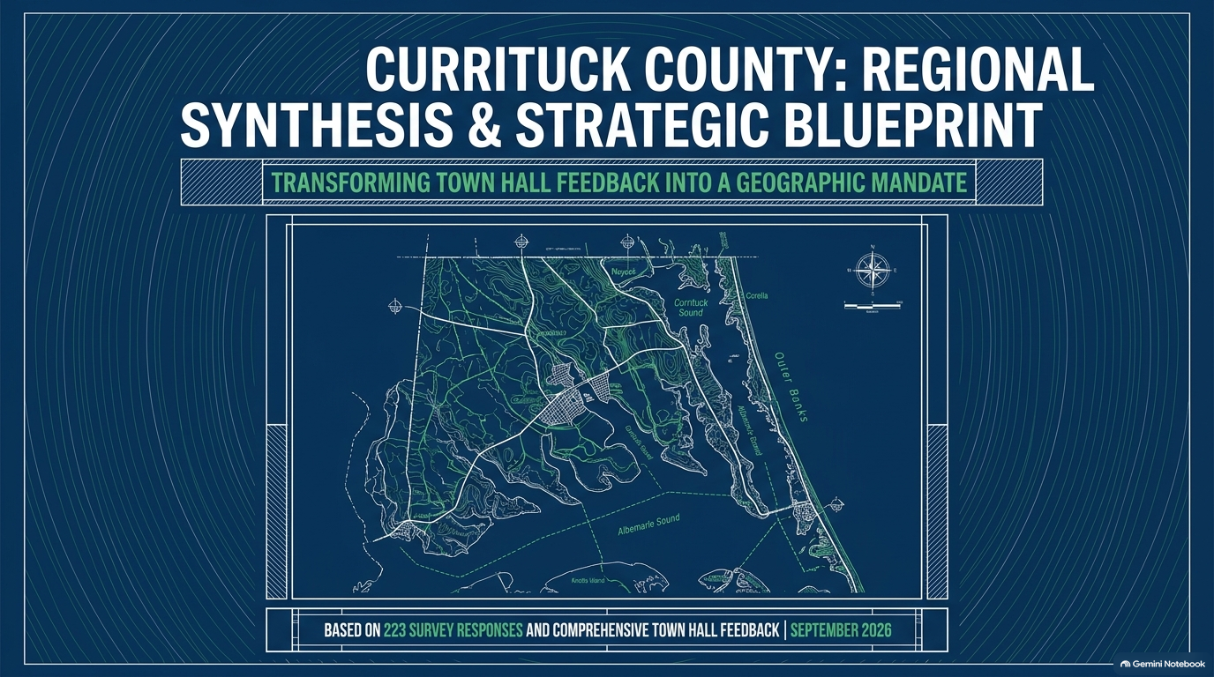
Currituck County: Regional Synthesis and Strategic Blueprint
Notes:
Accessibility description: Cover slide showing a map of Currituck County. Presentation synthesizes town hall feedback and survey responses from September 2026 into a geographic strategic blueprint.

Slide 2

A County at a Tipping Point
Notes:
Accessibility description: Balance-scale infographic contrasts record residential growth and tourism revenue with strained utility infrastructure, public safety lifelines, and commercial amenities. Central message: overcrowding is a county-wide issue, not only a school issue.

Slide 3
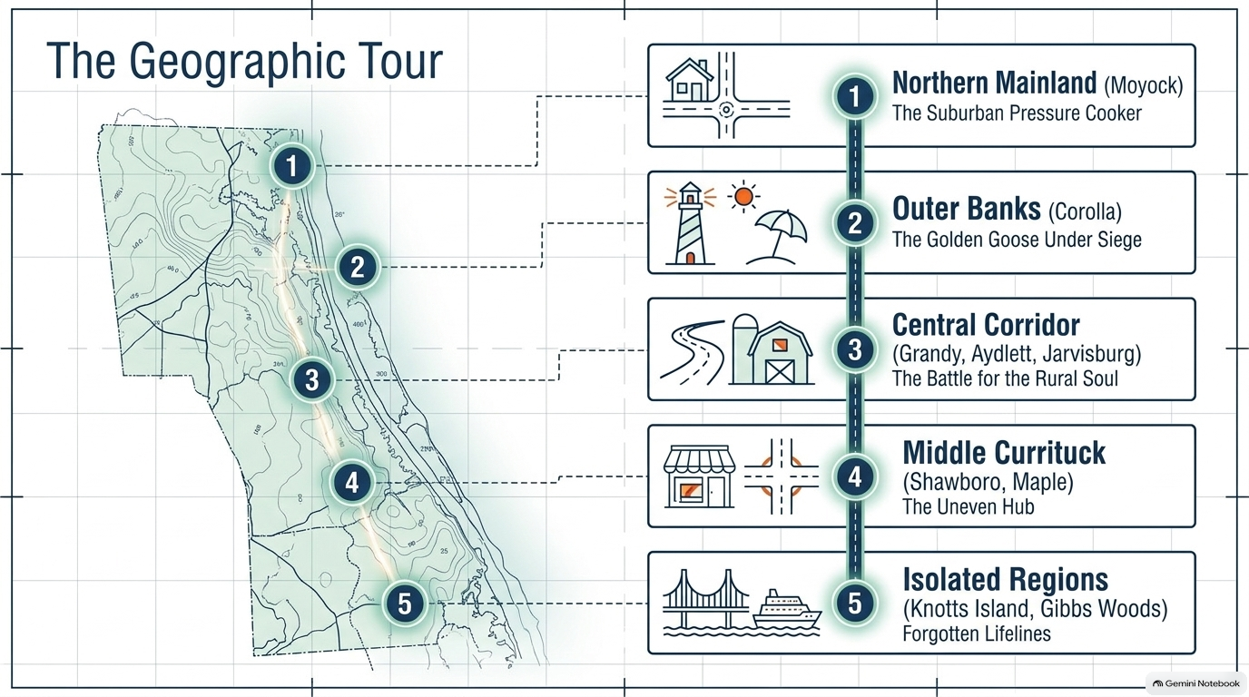
The Geographic Tour
Notes:
Accessibility description: Map identifies five regions addressed in the presentation: Northern Mainland, Moyock; Outer Banks, Corolla; Central Corridor, Grandy, Aydlett and Jarvisburg; Middle Currituck, Shawboro and Maple; and isolated Knotts Island and Gibbs Woods.

Slide 4
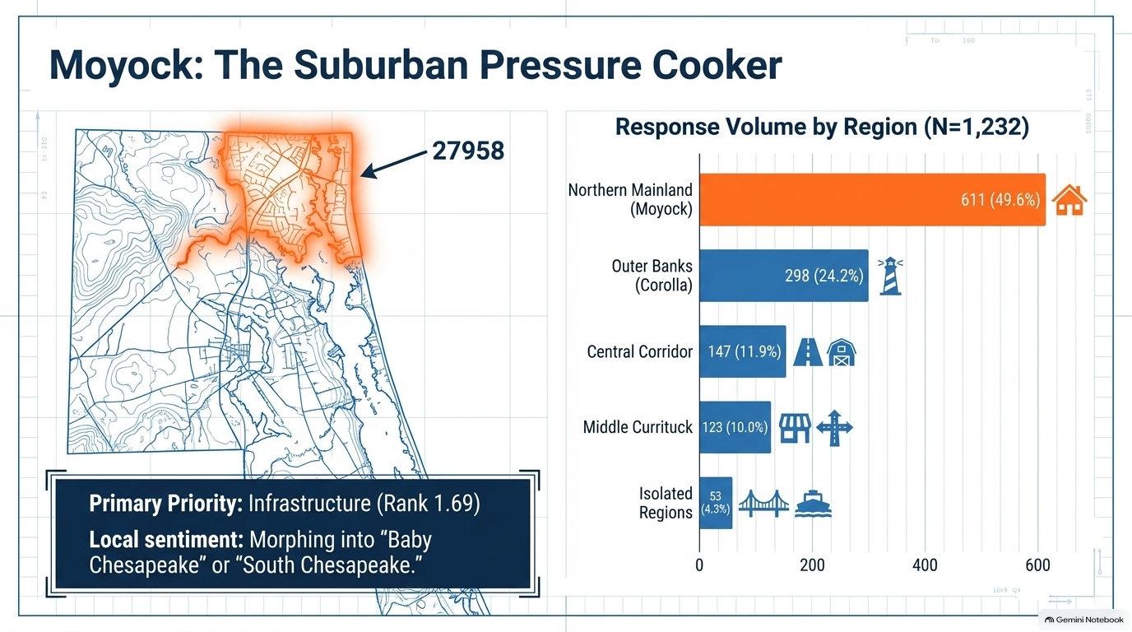
Moyock: The Suburban Pressure Cooker
Notes:
Accessibility description: Map highlights Moyock ZIP code 27958. Survey response bar chart shows Northern Mainland 611, 49.6 percent; Outer Banks 298, 24.2 percent; Central Corridor 147, 11.9 percent; Middle Currituck 123, 10 percent; isolated regions 53, 4.3 percent. Infrastructure is the top priority, ranked 1.69.

Slide 5

The Demographic Divide in Moyock
Notes:
Accessibility description: Balance diagram contrasts transient commuters, described as 75 percent, with the essential local workforce, 25 percent. Rising home values and scarce affordable rentals or starter homes affect teachers, county employees and young families. A callout conveys residents’ concerns about builder concentration and construction quality.

Slide 6
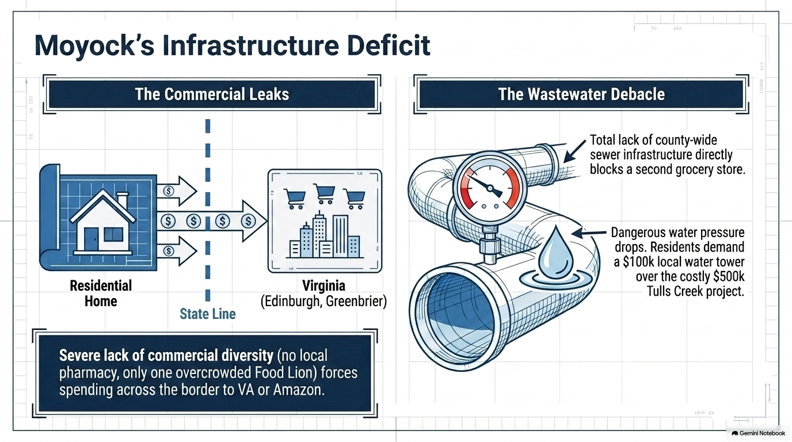
Moyock's Infrastructure Deficit
Notes:
Accessibility description: Two diagrams describe commercial spending leaving Moyock for Virginia because of limited local retail and pharmacy options, and wastewater and water-pressure concerns. The slide says lack of sewer infrastructure hinders another grocery store and compares a proposed local water tower with a more expensive Tulls Creek project.

Slide 7
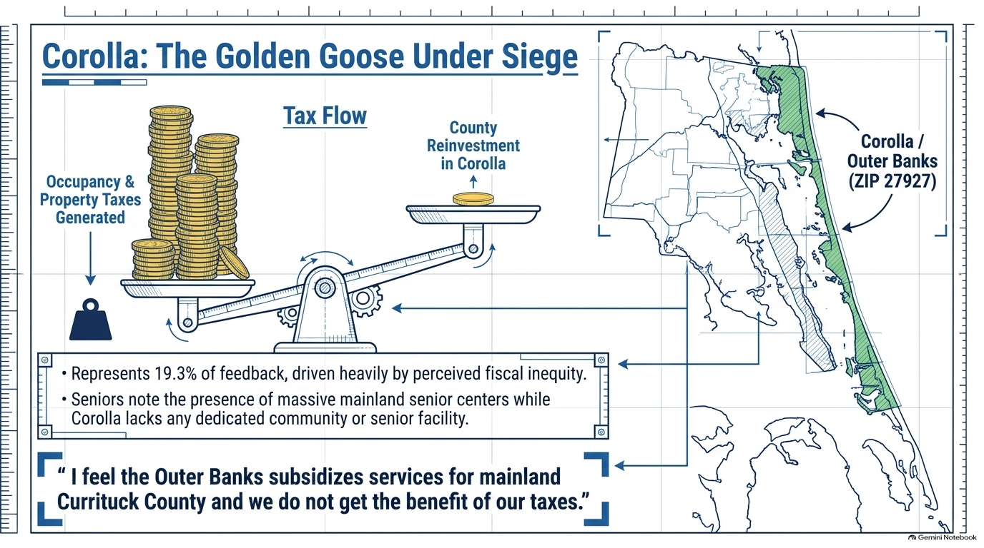
Corolla: The Golden Goose Under Siege
Notes:
Accessibility description: Tax-flow balance illustration shows perceived disparity between occupancy and property taxes generated in Corolla and county reinvestment there. A map highlights Corolla, ZIP code 27927. Residents cite a lack of dedicated community and senior facilities and concerns that Outer Banks taxes subsidize mainland services.

Slide 8
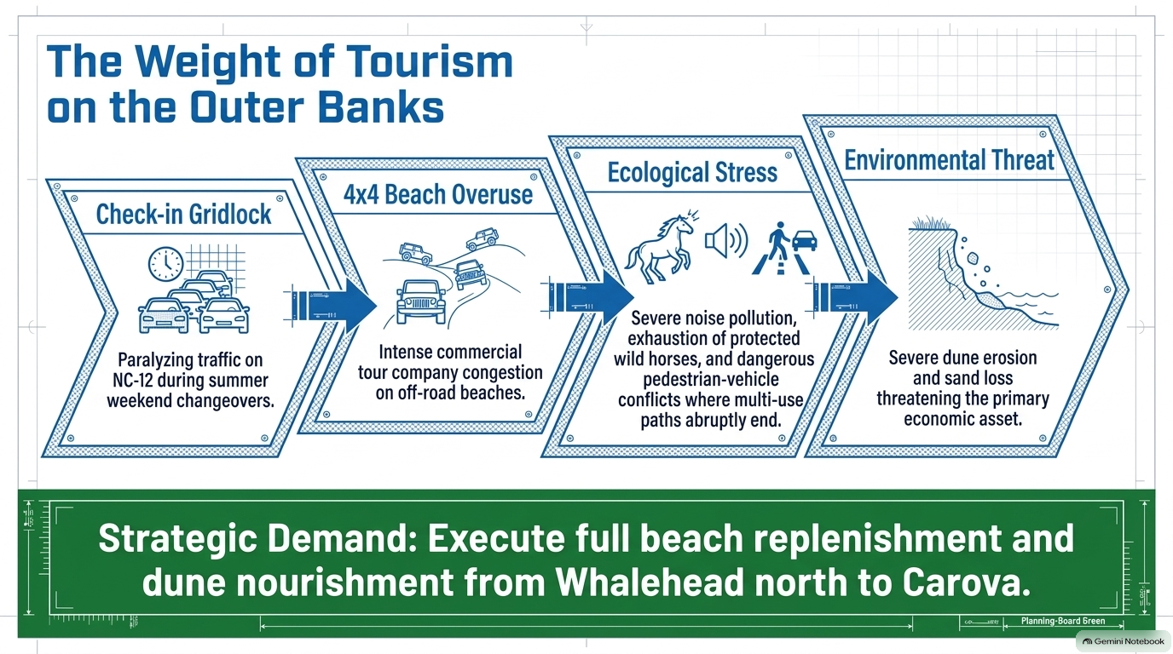
The Weight of Tourism on the Outer Banks
Notes:
Accessibility description: Four linked panels illustrate NC-12 summer check-in traffic, commercial four-wheel-drive beach congestion, stress on wild horses and pedestrian safety, and dune erosion. The stated strategic demand is beach replenishment and dune nourishment from Whalehead north to Carova.

Slide 9
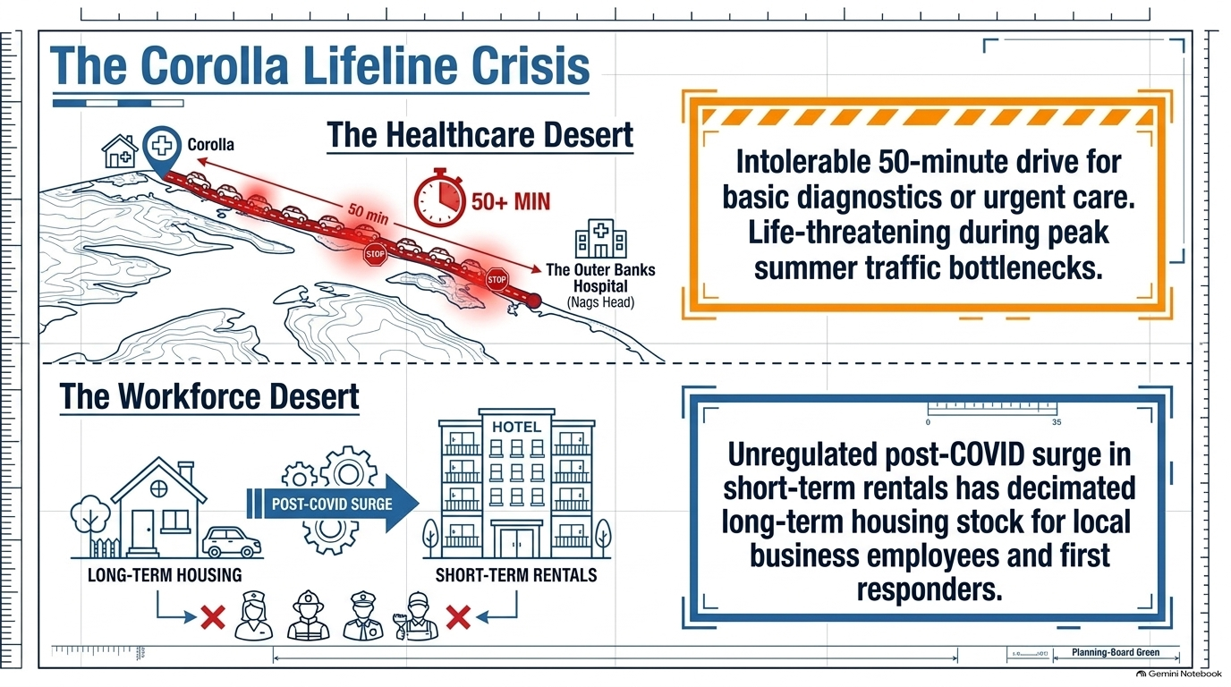
The Corolla Lifeline Crisis
Notes:
Accessibility description: Upper diagram depicts a drive of more than 50 minutes from Corolla to Outer Banks Hospital for basic diagnostics or urgent care during traffic. Lower diagram shows long-term housing displaced by short-term rentals, limiting housing for local employees and first responders.

Slide 10
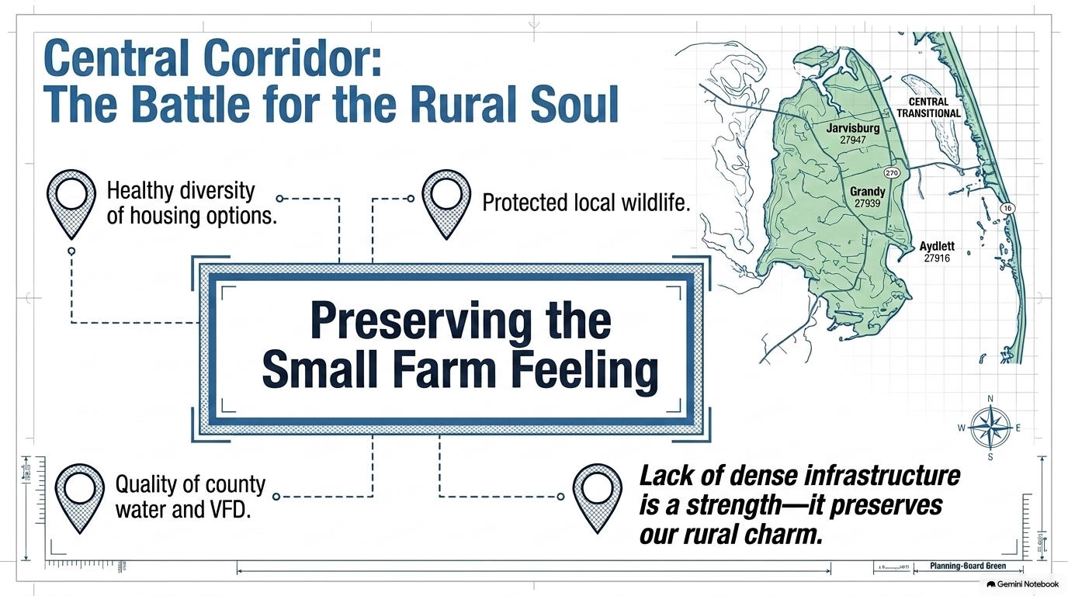
Central Corridor: The Battle for the Rural Soul
Notes:
Accessibility description: Map highlights Jarvisburg, Grandy and Aydlett. Central theme is preserving a small-farm feeling through housing diversity, wildlife protection, county water and volunteer fire services, while recognizing that limited dense infrastructure helps retain rural character.

Slide 11
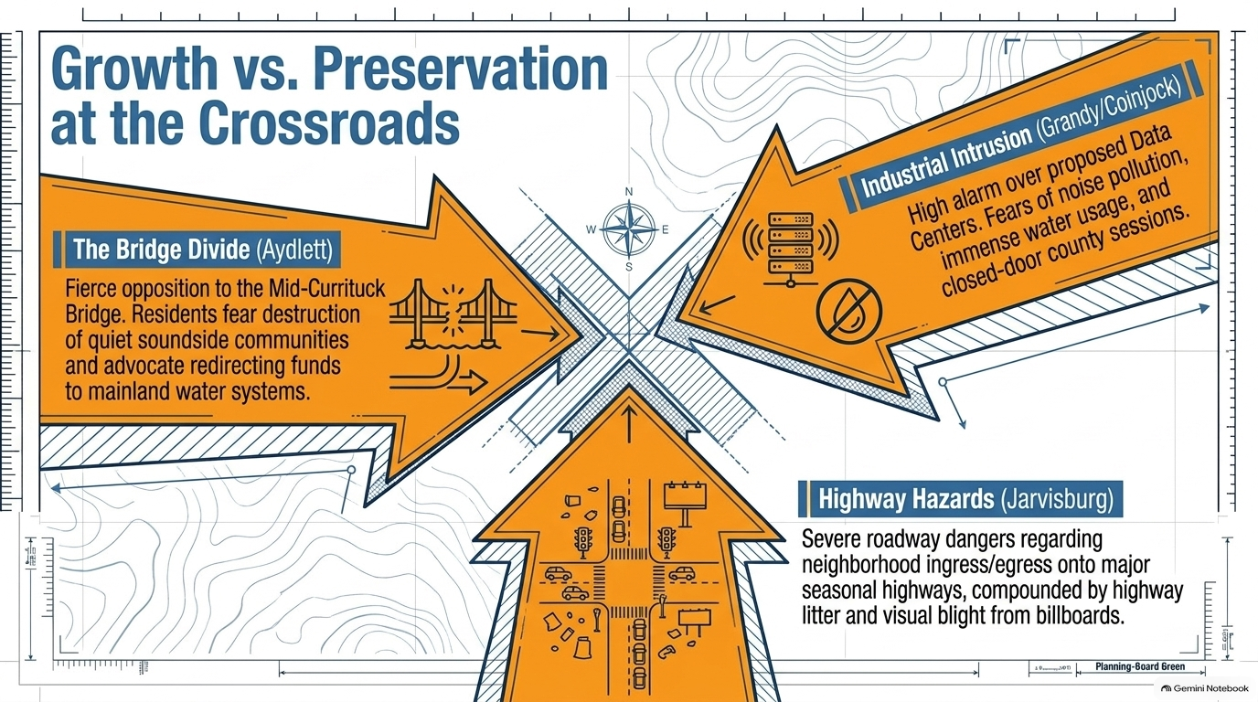
Growth versus Preservation at the Crossroads
Notes:
Accessibility description: Three converging arrows represent opposition to the Mid-Currituck Bridge in Aydlett, concern over proposed data centers in Grandy and Coinjock, and roadway safety and highway litter concerns in Jarvisburg.

Slide 12
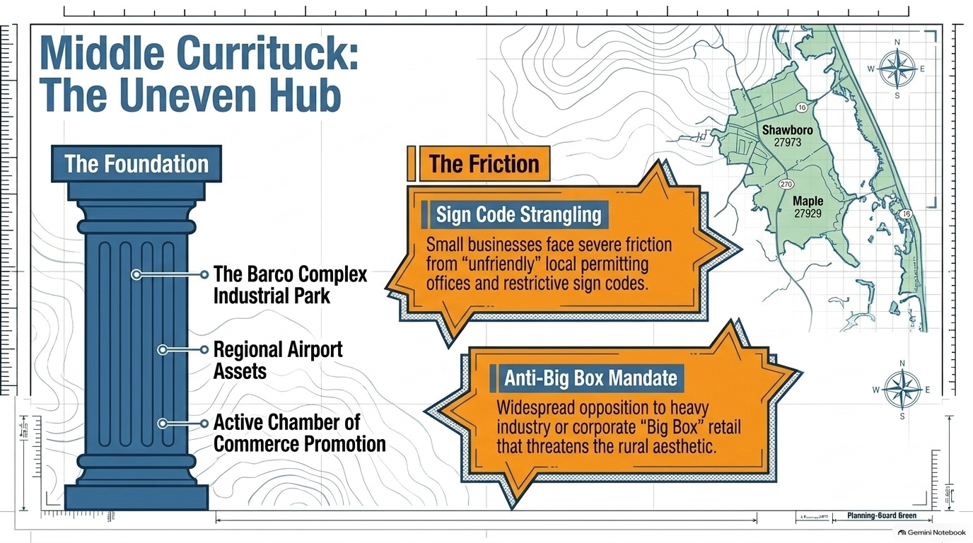
Middle Currituck: The Uneven Hub
Notes:
Accessibility description: Map of Shawboro and Maple. A foundation column identifies the Barco Complex Industrial Park, regional airport assets and Chamber of Commerce promotion. Orange callouts report concerns about restrictive sign codes and permitting, and opposition to large-format retail or heavy industry.

Slide 13
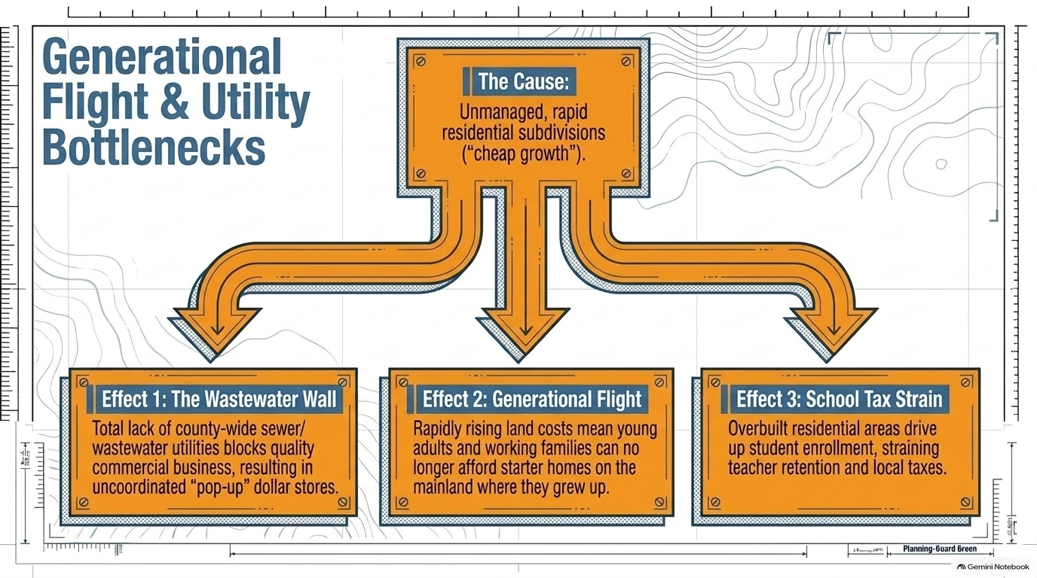
Generational Flight and Utility Bottlenecks
Notes:
Accessibility description: Flow diagram attributes three consequences to rapid unmanaged residential subdivisions: lack of sewer infrastructure limiting commercial development, unaffordable starter homes driving younger residents away, and school enrollment growth straining teachers and local taxes.

Slide 14
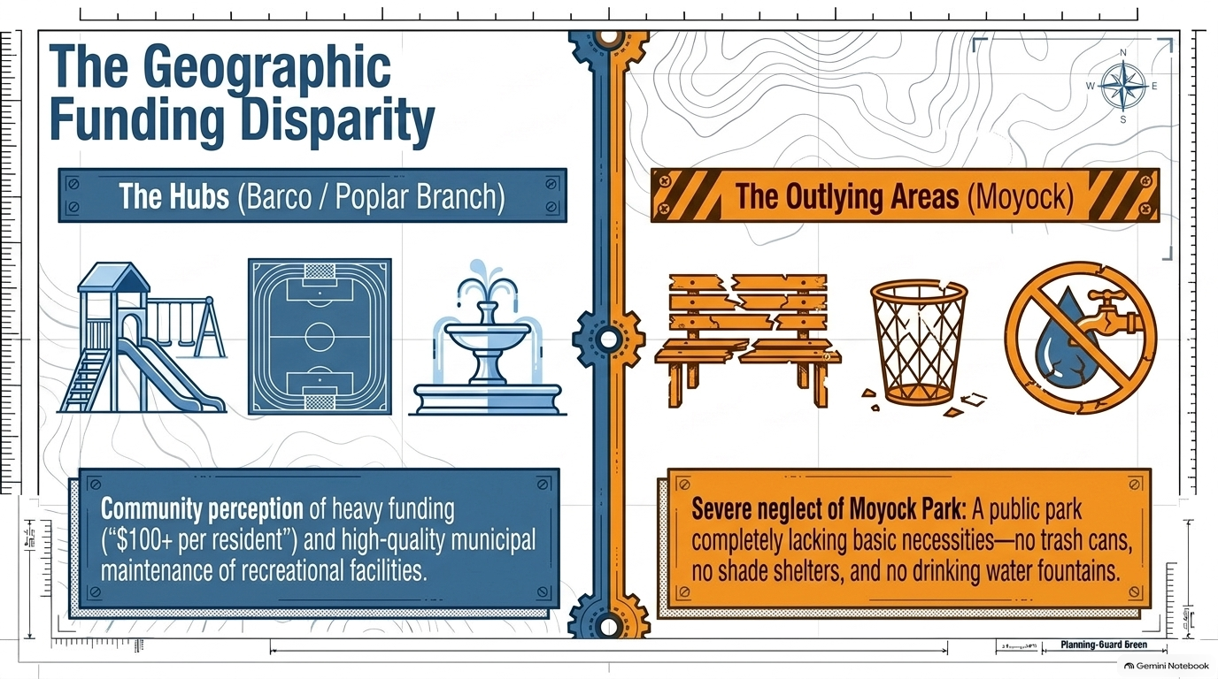
The Geographic Funding Disparity
Notes:
Accessibility description: Side-by-side comparison contrasts perceived investment in recreation facilities in Barco and Poplar Branch with reported deficiencies at Moyock Park, including lack of trash cans, shade shelters and drinking fountains.

Slide 15
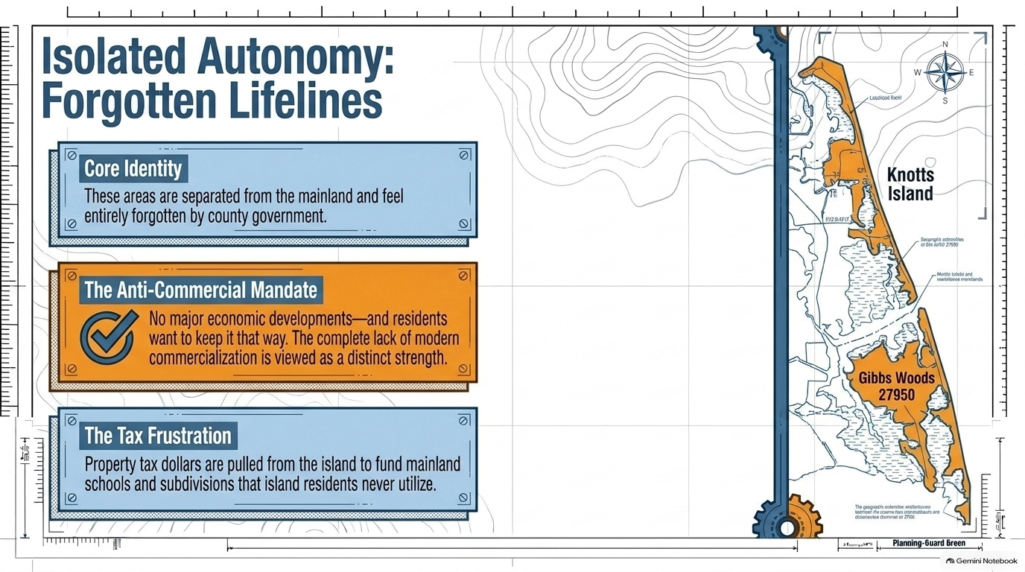
Isolated Autonomy: Forgotten Lifelines
Notes:
Accessibility description: Map highlights Knotts Island and Gibbs Woods. Three callouts describe feelings of geographic isolation, a preference to avoid major commercial development, and frustration over taxes supporting mainland facilities.

Slide 16
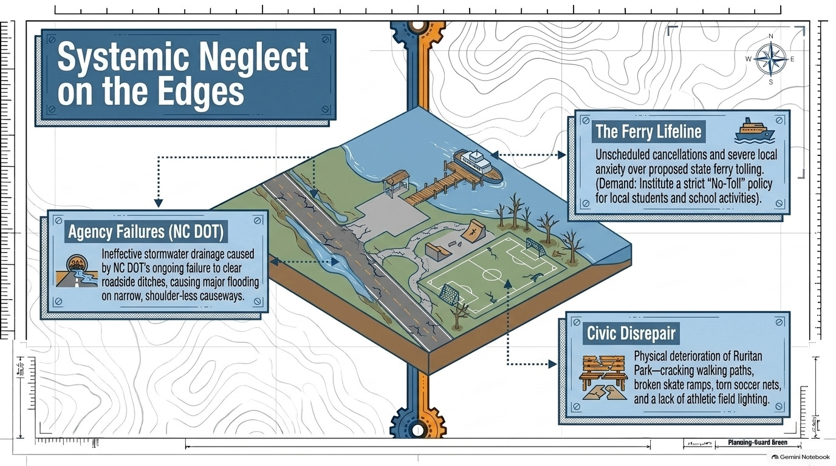
Systemic Neglect on the Edges
Notes:
Accessibility description: Illustration of ferry landing, roadway drainage and recreation area. Callouts describe ferry cancellations and concerns about tolls for local school activities, roadside flooding attributed to drainage problems, and deteriorating Ruritan Park walking paths, ramps, soccer nets and lighting.

Slide 17

The Gibbs Woods EMS Crisis
Notes:
Accessibility description: Large clock symbolizes an ambulance wait of up to one hour for Gibbs Woods residents during emergencies. The slide attributes the concern to geographic separation and unreliable dependence on Virginia Beach mutual aid.

Slide 18
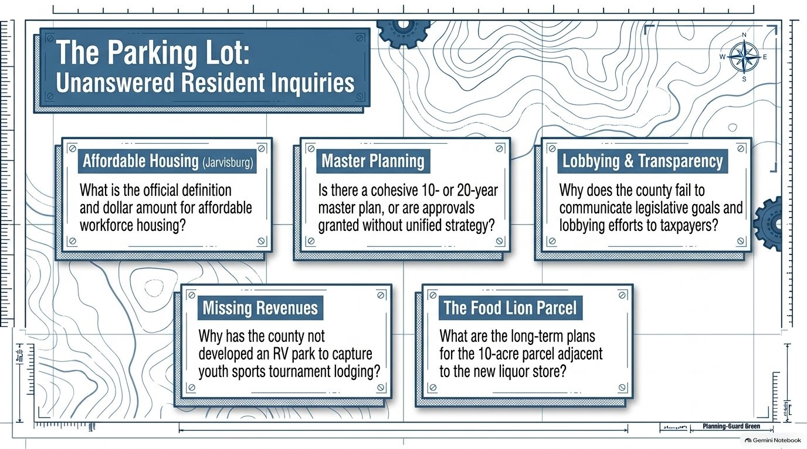
The Parking Lot: Unanswered Resident Inquiries
Notes:
Accessibility description: Five unanswered questions concern the definition and price threshold of affordable workforce housing, long-term master planning, communication of county lobbying goals, potential RV park revenues from youth sports tournaments, and plans for a ten-acre parcel next to a new liquor store.

